Slide 1
Pokemon Wang
By Wang

Slide 2
UML Diagram
Pokemon
Starter

Slide 3
The design
I had no “differences of opinion” with Wang1, Wang2, or Wang3 because I am an amazing person
A starter “is a” pokemon, in this case Mudkip, Treecko, or Torchic
The starter class has the type of pokemon, the name, the damage stat, and calculates the damage
The pokemon class has the health and its calculations, level, and the name of the attack the pokemon has.

Slide 4
The design
A lot changed from my original design
I went from a console based game to a GUI mainly, and added a leveling system
I also only wanted it to battle once because I was too lazy before but here we are.
I used a null layout for the GUI, and placed everything around using setBounds instead of using a better layout in the first place.

Slide 5
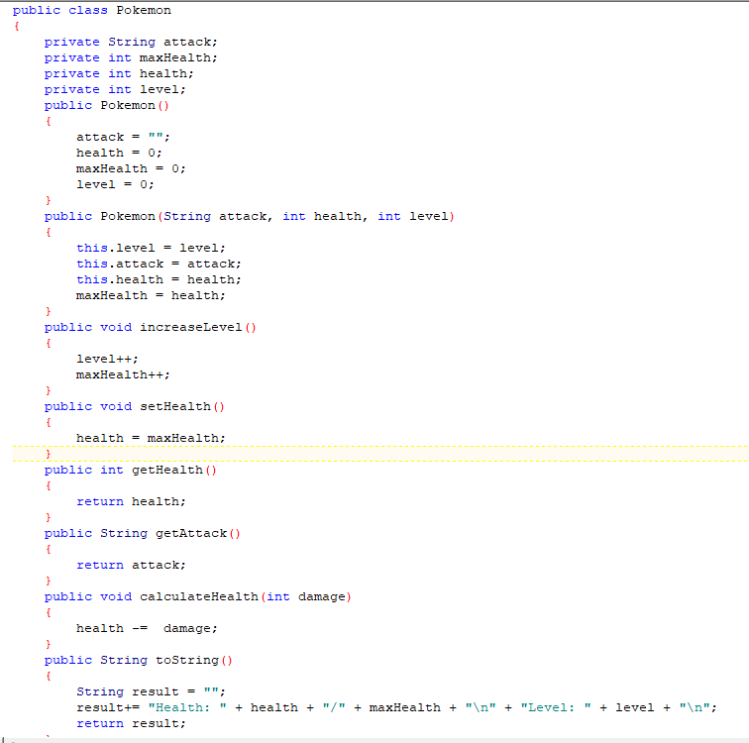
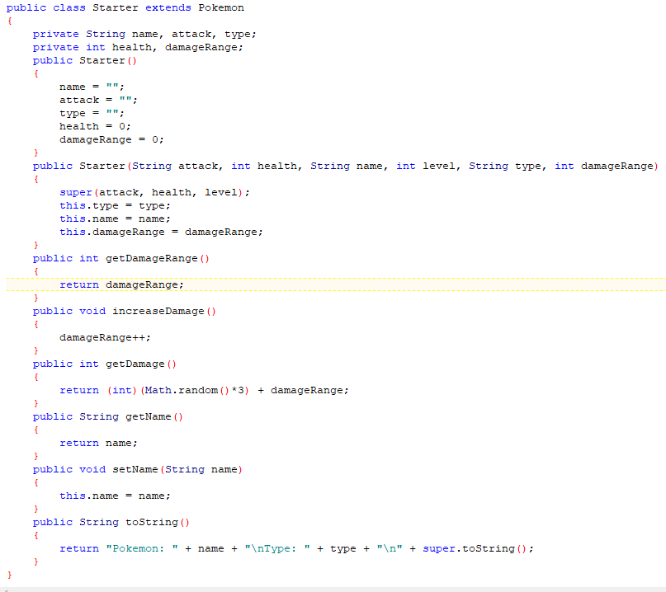

Slide 6
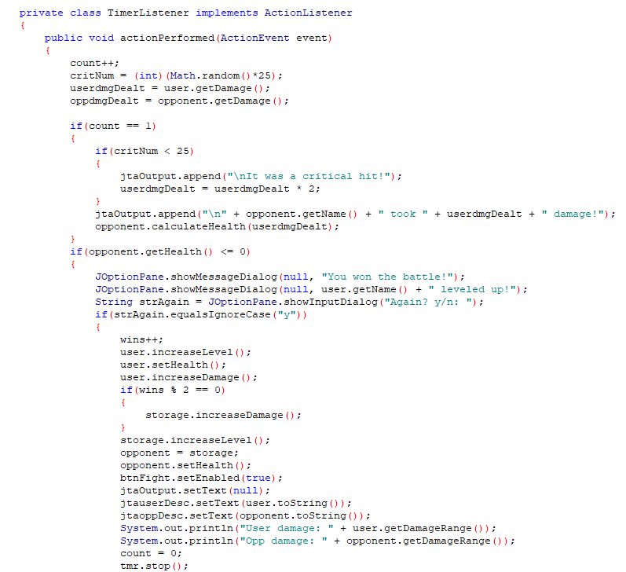
I originally wanted to use Thread.sleep, but it didn’t do what I wanted it to
So I threw everything into a timer instead
I also only wanted to have it battle one time, but here we are

Slide 7
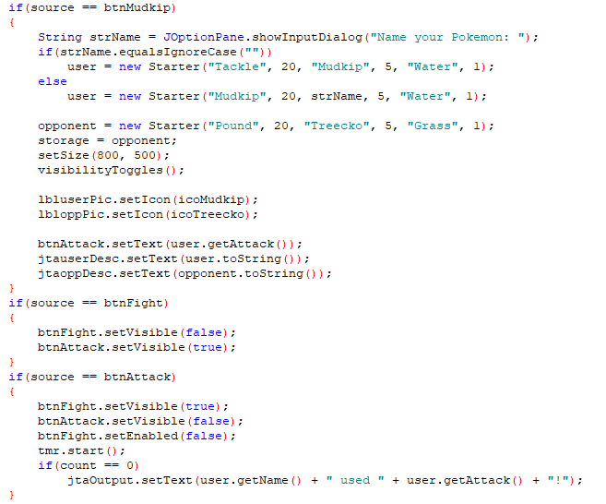
What happens when you click certain buttons

Slide 8

Thanks to Sangjun Ko for giving me permission to use his face

